Slide 1
Regex for Rockstars
Thomas Rayner

Slide 2
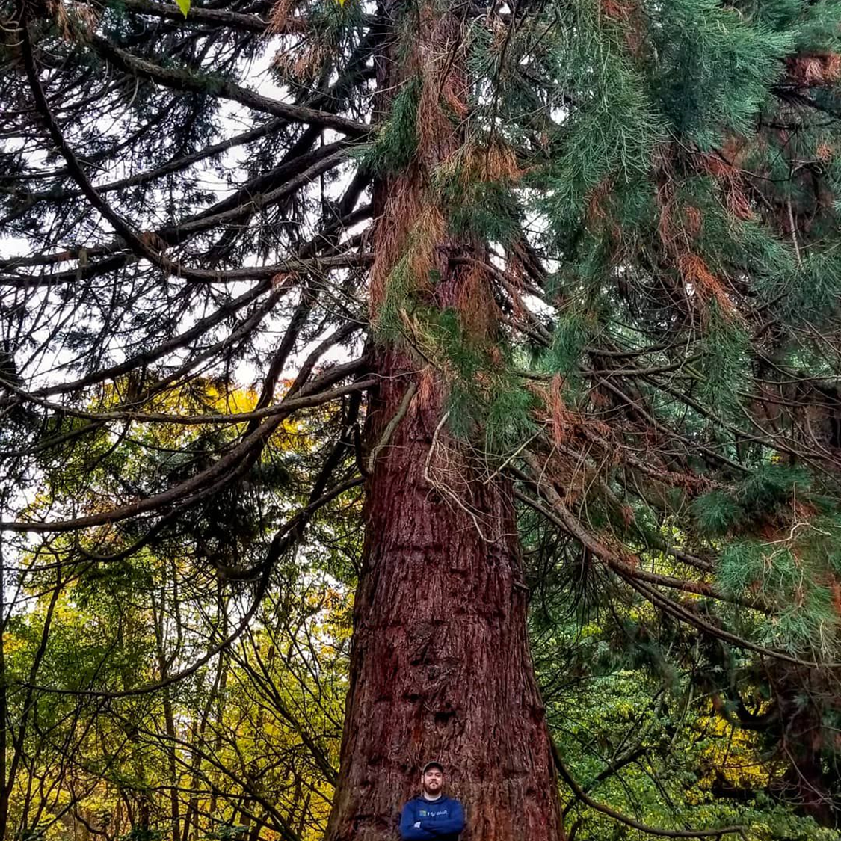
Thomas Rayner
Certified Information Systems Security Professional (CISSP)
Sr Security Service Engineer @ Microsoft
@MrThomasRayner
thomasrayner.ca | PowerShell Discord/Slack aka.ms/psdiscord aka.ms/psslack
github.com/thomasrayner | pluralsight.com/authors/thomas-rayner

Slide 3
Recap For Noobs
Just in case you missed it

Slide 4
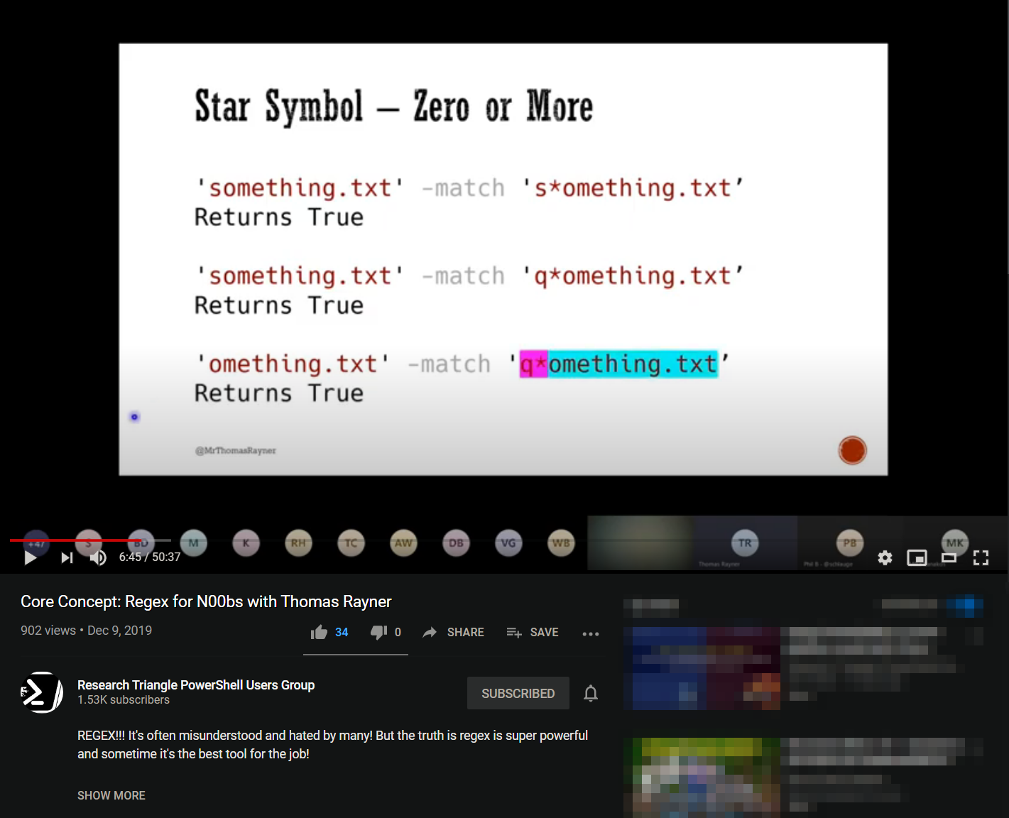
Regex For Noobs
https://youtu.be/EcASUAi1B0k
Notes:
https://youtu.be/EcASUAi1B0k

Slide 5
What is regex?
Short for “regular expression”
Sequence of characters that defines a search pattern
Used to find or replace items in strings
Especially handy for
Extracting text from files like logs
Determining if a value exists in some user input
Replacing parts of a string with other values

Slide 6
You’re already doing it!
$arrayOfStuff = @('somethingone', 'somethingtwo', 'noway')
$arrayOfStuff | Where-Object { $_ -match 'something’ }
Returns
somethingone
somethingtwo

Slide 7
You’re already doing it!
$arrayOfStuff = @('somethingone', 'somethingtwo', 'noway')
$arrayOfStuff | Where-Object { $_ -match 'something’ }
Returns
somethingone
somethingtwo

Slide 8
Boolean Matching
'somethingone' -match 'something’
Returns True

Slide 9
Boolean Matching
'somethingone' -match 'something’
Returns True

Slide 10
Boolean Matching
'somethingone' -match 'something’
Returns True
'somethingone' -match 'pickles’
Returns False

Slide 11
Boolean Matching
'somethingone' -match 'something’
Returns True
'somethingone' -match 'pickles’
Returns False

Slide 12
Simple Replacements
'Here is a simple string.' -replace 'simple string', 'string that got something replaced’
Returns
Here is a string that got something replaced.

Slide 13
Simple Replacements
'Here is a simple string.' -replace 'simple string', 'string that got something replaced’
Returns
Here is a string that got something replaced.

Slide 14
Simple Replacements
'Here is a simple string.' -replace 'simple string', 'string that got something replaced’
Returns
Here is a string that got something replaced.

Slide 15
Quantifiers
How many of whatever

Slide 16
Quantifiers
'omething.txt' -match 's*omething.txt'
Returns True

Slide 17
Quantifiers
'_omething.txt' -match 's*omething.txt'
Returns True

Slide 18
Quantifiers
'omething.txt' -match 's*omething.txt'
Returns True

Slide 19
Quantifiers
'omething.txt' -match 's*omething.txt'
Returns True
'omething.txt' -match 's+omething.txt'
Returns False

Slide 20
Quantifiers
'omething.txt' -match 's*omething.txt'
Returns True
'omething.txt' -match 's+omething.txt'
Returns False

Slide 21
Quantifiers
'omething.txt' -match 's*omething.txt'
Returns True
'omething.txt' -match 's+omething.txt'
Returns False

Slide 22
Quantifiers
'omething.txt' -match 's*omething.txt'
Returns True
'omething.txt' -match 's+omething.txt'
Returns False
'something.txt' -match 's?omething.txt'
Returns True

Slide 23
Quantifiers
'omething.txt' -match 's*omething.txt'
Returns True
'omething.txt' -match 's+omething.txt'
Returns False
'something.txt' -match 's?omething.txt'
Returns True

Slide 24
Quantifiers
'omething.txt' -match 's*omething.txt'
Returns True
'omething.txt' -match 's+omething.txt'
Returns False
'something.txt' -match 's?omething.txt'
Returns True

Slide 25
Quantifiers
'omething.txt' -match 's*omething.txt'
Returns True
'omething.txt' -match 's+omething.txt'
Returns False
'something.txt' -match 's?omething.txt'
Returns True

Slide 26
Special Symbols
^\where things st\Art getting \weir\d$

Slide 27
A quick Refresher
^ Start of line
$ End of line
\A Start of string
\z End of string
. Any single character
\s Any whitespace char
\S Any non-whitespace char
\d Any digit
\D Any non-digit
\w Any word char
letter, number, underscore
\W Any non-word char
\b Any word boundary

Slide 28
Special Symbols
'something' -match 'some.hing'
Returns True

Slide 29
Special Symbols
'something' -match 'some.hing'
Returns True

Slide 30
Special Symbols
'something' -match 'some.hing'
Returns True

Slide 31
Special Symbols
'something' -match 'some.hing'
Returns True
'123' -match '\d'
Returns True

Slide 32
Special Symbols
'something' -match 'some.hing'
Returns True
'123' -match '\d'
Returns True

Slide 33
Special Symbols
'something' -match 'some.hing'
Returns True
'123' -match '\d'
Returns True

Slide 34
Special Symbols
'something' -match 'some.hing'
Returns True
'123' -match '\d'
Returns True

Slide 35
Special Symbols
'something' -match 'some.hing'
Returns True
'123' -match '\d'
Returns True

Slide 36
Special Symbols
'something' -match 'some.hing'
Returns True
'123' -match '\d'
Returns True

Slide 37
Special Symbols
'something' -match 'some.hing'
Returns True
'123' -match '\d'
Returns True
'123' -match '\D'
Returns False

Slide 38
Special Symbols
'something' -match 'some.hing'
Returns True
'123' -match '\d'
Returns True
'123' -match '\D'
Returns False

Slide 39
Special Symbols
'something' -match 'some.hing'
Returns True
'123' -match '\d'
Returns True
'123' -match '\D'
Returns False
'hello123' -match '\w'
Returns True

Slide 40
Special Symbols
'something' -match 'some.hing'
Returns True
'123' -match '\d'
Returns True
'123' -match '\D'
Returns False
'hello123' -match '\w'
Returns True

Slide 41
Special Symbols
'something' -match 'some.hing'
Returns True
'123' -match '\d'
Returns True
'123' -match '\D'
Returns False
'hello123' -match '\w'
Returns True
'hi' -match '^hi$'
Returns True

Slide 42
Special Symbols
'something' -match 'some.hing'
Returns True
'123' -match '\d'
Returns True
'123' -match '\D'
Returns False
'hello123' -match '\w'
Returns True
'_hi_' -match '^hi$'
Returns True

Slide 43
Special Symbols
'something' -match 'some.hing'
Returns True
'123' -match '\d'
Returns True
'123' -match '\D'
Returns False
'hello123' -match '\w'
Returns True
'hi' -match '^hi$'
Returns True

Slide 44
Special Symbols
'something' -match 'some.hing'
Returns True
'123' -match '\d'
Returns True
'123' -match '\D'
Returns False
'hello123' -match '\w'
Returns True
'hi' -match '^hi$'
Returns True
'\\p\w\slash' -match '\slash'
Returns False

Slide 45
Special Symbols
'something' -match 'some.hing'
Returns True
'123' -match '\d'
Returns True
'123' -match '\D'
Returns False
'hello123' -match '\w'
Returns True
'hi' -match '^hi$'
Returns True
'\\p\w\slash' -match '\slash'
Returns False

Slide 46
Special Symbols
'something' -match 'some.hing'
Returns True
'123' -match '\d'
Returns True
'123' -match '\D'
Returns False
'hello123' -match '\w'
Returns True
'hi' -match '^hi$'
Returns True
'\\p\w\slash' -match '\slash'
Returns False

Slide 47
Special Symbols
'something' -match 'some.hing'
Returns True
'123' -match '\d'
Returns True
'123' -match '\D'
Returns False
'hello123' -match '\w'
Returns True
'hi' -match '^hi$'
Returns True
'\\p\w\slash' -match '\\slash'
Returns True

Slide 48
Special Symbols
'something' -match 'some.hing'
Returns True
'123' -match '\d'
Returns True
'123' -match '\D'
Returns False
'hello123' -match '\w'
Returns True
'hi' -match '^hi$'
Returns True
'\\p\w\slash' -match '\\slash'
Returns True

Slide 49
Special Symbols
'something' -match 'some.hing'
Returns True
'123' -match '\d'
Returns True
'123' -match '\D'
Returns False
'hello123' -match '\w'
Returns True
'hi' -match '^hi$'
Returns True
'\\p\w\slash' -match '\\slash'
Returns True

Slide 50
A quick Refresher
^ Start of line
$ End of line
\A Start of string
\z End of string
. Any single character
\s Any whitespace char
\S Any non-whitespace char
\d Any digit
\D Any non-digit
\w Any word char
letter, number, underscore
\W Any non-word char
\b Any word boundary

Slide 51
Brackets
Round, square, and curly

Slide 52
Brackets
'something123' -match '\d{3}'
Returns True

Slide 53
Brackets
'something123' -match '\d{3}'
Returns True

Slide 54
Brackets
'something123' -match '\d{3}'
Returns True

Slide 55
Brackets
'something123' -match '\d{3}'
Returns True
'hello123hello123' -match '(hello123){2}'
Returns True

Slide 56
Brackets
'something123' -match '\d{3}'
Returns True
'hello123hello123' -match '(hello123){2}'
Returns True

Slide 57
Brackets
'something123' -match '\d{3}'
Returns True
'hello123hello123' -match '(hello123){2}'
Returns True

Slide 58
Brackets
'something123' -match '\d{3}'
Returns True
'hello123hello123' -match '(hello123){2}'
Returns True
'something' -match '[fgh]$'
Returns True

Slide 59
Brackets
'something123' -match '\d{3}'
Returns True
'hello123hello123' -match '(hello123){2}'
Returns True
'something_' -match '[fgh]$'
Returns True

Slide 60
Brackets
'something123' -match '\d{3}'
Returns True
'hello123hello123' -match '(hello123){2}'
Returns True
'something' -match '[fgh]$'
Returns True

Slide 61
Brackets
'something123' -match '\d{3}'
Returns True
'hello123hello123' -match '(hello123){2}'
Returns True
'something' -match '[fgh]$'
Returns True

Slide 62
[Regex]
Classing things up a little

Slide 63
Better Than Booleans
[regex]::Matches('domain\username', '\w+$')
Returns
Groups : {0}
Success : True
Name : 0
Captures : {0}
Index : 7
Length : 8
Value : username

Slide 64
Better Than Booleans
[regex]::Matches('domain\username_', '\w+$')
Returns
Groups : {0}
Success : True
Name : 0
Captures : {0}
Index : 7
Length : 8
Value : username

Slide 65
Better Than Booleans
[regex]::Matches('domain\username', '\w+$')
Returns
Groups : {0}
Success : True
Name : 0
Captures : {0}
Index : 7
Length : 8
Value : username

Slide 66
Better Than Booleans
[regex]::Matches('domain\username', '\w+$')
Returns
Groups : {0}
Success : True
Name : 0
Captures : {0}
Index : 7
Length : 8
Value : username
[regex]::Matches('domain\username', '\w+$').Value
Returns
username

Slide 67
Better Than Booleans
[regex]::Matches('domain\username', '\w+$')
Returns
Groups : {0}
Success : True
Name : 0
Captures : {0}
Index : 7
Length : 8
Value : username
[regex]::Matches('domain\username', '\w+$').Value
Returns
username
There's plenty more methods in the [regex] class

Slide 68
Rockstar Time
🌟🎸💎🌠🎶🥁🚀🏴‍☠️🎙⚡

Slide 69
Parsing HTML
Just kidding – DO NOT DO THIS
Regex is powerful, but not the perfect tool for every scenario

Slide 70
Grouping
(RoundBrackets)++

Slide 71
Grouping
[regex]::Match('Bond. James Bond.', 'James\sBond')
Returns
Groups : {0} Success : True Name : 0 Captures : {0} Index : 6 Length : 10 Value : James Bond

Slide 72
Grouping
$pat = '(?<first>James)\s(?<last>Bond)'
$mat = [regex]::Match('Bond. James Bond.', $pat)

Slide 73
Grouping
$pat = '(?<first>James)\s(?<last>Bond)'
$mat = [regex]::Match('Bond. James Bond.', $pat)

Slide 74
Grouping
$pat = '(?<first>James)\s(?<last>Bond)'
$mat = [regex]::Match('Bond. James Bond.', $pat)

Slide 75
Grouping
$pat = '(?<first>James)\s(?<last>Bond)'
$mat = [regex]::Match('Bond. James Bond.', $pat)

Slide 76
Grouping
$pat = '(?<first>James)\s(?<last>Bond)'
$mat = [regex]::Match('Bond. James Bond.', $pat)

Slide 77
Grouping
$pat = '(?<first>James)\s(?<last>Bond)'
$mat = [regex]::Match('Bond. James Bond.', $pat)

Slide 78
Grouping
$pat = '(?<first>James)\s(?<last>Bond)'
$mat = [regex]::Match('Bond. James Bond.', $pat)
$mat contains
Groups : {0, first, last}
Success : True
Name : 0
Captures : {0}
Index : 6
Length : 10
Value : James Bond

Slide 79
Grouping
$pat = '(?<first>James)\s(?<last>Bond)'
$mat = [regex]::Match('Bond. James Bond.', $pat)
$mat contains
Groups : {0, first, last}
Success : True
Name : 0
Captures : {0}
Index : 6
Length : 10
Value : James Bond

Slide 80
Grouping
$pat = '(?<first>James)\s(?<last>Bond)'
$mat = [regex]::Match('Bond. James Bond.', $pat)
$mat.Groups contains
Groups : {0, first, last}
Success : True
Name : 0
Captures : {0}
Index : 6
Length : 10
Value : James Bond
Success : True
Name : first
Captures : {first}
Index : 6
Length : 5
Value : James
Success : True
Name : last
Captures : {last}
Index : 12
Length : 4
Value : Bond

Slide 81
Grouping
$pat = '(?<first>James)\s(?<last>Bond)'
$mat = [regex]::Match('Bond. James Bond.', $pat)
$mat.Groups contains
Groups : {0, first, last}
Success : True
Name : 0
Captures : {0}
Index : 6
Length : 10
Value : James Bond
Success : True
Name : first
Captures : {first}
Index : 6
Length : 5
Value : James
Success : True
Name : last
Captures : {last}
Index : 12
Length : 4
Value : Bond

Slide 82
Grouping
$pat = '(?<first>James)\s(?<last>Bond)'
$mat = [regex]::Match('Bond. James Bond.', $pat)
$mat.Groups['first']
Returns
Success : True
Name : first
Captures : {first}
Index : 6
Length : 5
Value : James

Slide 83
Grouping
$pat = '(?<first>James)\s(?<last>Bond)'
$mat = [regex]::Match('Bond. James Bond.', $pat)
$mat.Groups['first']
$mat.Groups['first'].Value
Returns
James

Slide 84
Grouping
$pat = '(?<first>James)\s(?<last>Bond)'
$mat = [regex]::Match('Bond. James Bond.', $pat)
$mat.Groups['first']
$mat.Groups['first'].Value
Returns
James

Slide 85
Grouping
$pat = '(?<first>James)\s(?<last>Bond)'
'Bond. James Bond.' -match $pat
Returns
True
$matches contains
Name Value
---- -----
last Bond
first James
0 James Bond

Slide 86
Grouping
$pat = '(?<first>James)\s(?<last>Bond)'
'Bond. James Bond.' -match $pat
Returns
True
$matches contains
Name Value
---- -----
last Bond
first James
0 James Bond

Slide 87
Grouping
$pat = '(?<first>James)\s(?<last>Bond)'
$null = 'Bond. James Bond.' -match $pat
$matches.last
Returns
Bond

Slide 88
Grouping
$pat = '(?<first>James)\s(?<last>Bond)'
$null = 'Bond. James Bond.' -match $pat
$matches.last
Returns
Bond

Slide 89


You can do a lot more with grouping than just named groups

Slide 90
Loohaheads
.:||||||||:.
/ \
( o o )
-------@@@@----------: :----------@@@@---------
`--'

Slide 91
What the heck is a lookahead?
Everything we've looked at so far works like…
Match a character
That character is a part of the value that gets returned
Except for ^ and $
What about if you want to match on a character/pattern but not have it returned?
'domain\username' and you just want domain
Lots of ways to do this that don't involve a lookahead

Slide 92
What the heck is a lookahead?
Everything we've looked at so far
Match a character
That character is a part of the value that gets returned
Except for ^ and $
What about if you want to match on a character/pattern but not have it returned?
'_domain\username' and you just want domain
Lots of ways to do this that don't involve a lookahead
^\w+

Slide 93
What the heck is a lookahead?
Everything we've looked at so far
Match a character
That character is a part of the value that gets returned
Except for ^ and $
What about if you want to match on a character/pattern but not have it returned?
'_domain\username' and you just want domain
Lots of ways to do this that don't involve a lookahead
^[^\\]*

Slide 94
What the heck is a lookahead?
Everything we've looked at so far
Match a character
That character is a part of the value that gets returned
Except for ^ and $
What about if you want to match on a character/pattern but not have it returned?
'domain\username' and you just want domain
Lots of ways to do this that don't involve a lookahead
(?<dom>\w+).(?<user>\w+)
$matches.dom

Slide 95
What the heck is a lookahead?
Everything we've looked at so far
Match a character
That character is a part of the value that gets returned
Except for ^ and $
What about if you want to match on a character/pattern but not have it returned?
'domain\username' and you just want domain
Lots of ways to do this that don't involve a lookahead
But for the purposes of illustration

Slide 96
What the heck is a lookahead?
Everything we've looked at so far
Match a character
That character is a part of the value that gets returned
Except for ^ and $
What about if you want to match on a character/pattern but not have it returned?
'domain\username' and you just want domain
Lots of ways to do this that don't involve a lookahead
But for the purposes of illustration
\w+(?=\\)

Slide 97
What the heck is a lookahead?
Everything we've looked at so far
Match a character
That character is a part of the value that gets returned
Except for ^ and $
What about if you want to match on a character/pattern but not have it returned?
'domain\username' and you just want domain
Lots of ways to do this that don't involve a lookahead
But for the purposes of illustration
\w+(?=\\)

Slide 98
What the heck is a lookahead?
Everything we've looked at so far
Match a character
That character is a part of the value that gets returned
Except for ^ and $
What about if you want to match on a character/pattern but not have it returned?
'domain\username' and you just want domain
Lots of ways to do this that don't involve a lookahead
But for the purposes of illustration
\w+(?=\\)

Slide 99
What the heck is a lookahead?
Everything we've looked at so far
Match a character
That character is a part of the value that gets returned
Except for ^ and $
What about if you want to match on a character/pattern but not have it returned?
'domain\username' and you just want domain
Lots of ways to do this that don't involve a lookahead
But for the purposes of illustration
\w+(?=\\)

Slide 100
What the heck is a lookahead?
Everything we've looked at so far
Match a character
That character is a part of the value that gets returned
Except for ^ and $
What about if you want to match on a character/pattern but not have it returned?
'domain\username' and you just want domain
Lots of ways to do this that don't involve a lookahead
But for the purposes of illustration
\w+(?=\\)

Slide 101
What the heck is a lookahead?
Everything we've looked at so far
Match a character
That character is a part of the value that gets returned
Except for ^ and $
What about if you want to match on a character/pattern but not have it returned?
'domain\username' and you just want domain
Lots of ways to do this that don't involve a lookahead
But for the purposes of illustration
\w+(?=\\)

Slide 102
What the heck is a lookahead?
Everything we've looked at so far
Match a character
That character is a part of the value that gets returned
Except for ^ and $
What about if you want to match on a character/pattern but not have it returned?
'domain\username' and you just want domain
Lots of ways to do this that don't involve a lookahead
But for the purposes of illustration
\w+(?=\\)

Slide 103
Lookaheads
'user@domain.tld' -match '\w+(?=\.tld)'
Returns True

Slide 104
Lookaheads
'user@domain.tld' -match '\w+(?=\.tld)'
Returns True

Slide 105
Lookaheads
'user@domain.tld' -match '\w+(?=\.tld)'
Returns True

Slide 106
Lookaheads
'user@domain.tld' -match '\w+(?=\.tld)'
Returns True

Slide 107
Lookaheads
'user@domain.tld' -match '\w+(?=\.tld)'
Returns True
$matches[0] -eq 'domain'

Slide 108
Lookaheads
'user@domain.tld' -match '\w+(?=\.tld)'
Returns True
$matches[0] -eq 'domain'
'user@domain.else' -match '\w+(?=\.tld)'
Returns False

Slide 109
Lookaheads
'user@domain.tld' -match '\w+(?=\.tld)'
Returns True
$matches[0] -eq 'domain'
'user@domain.else' -match '\w+(?=\.tld)'
Returns False

Slide 110
Lookaheads
'user@domain.tld' -match '\w+(?=\.tld)'
Returns True
$matches[0] -eq 'domain'
'user@domain.else' -match '\w+(?=\.tld)'
Returns False

Slide 111
Lookaheads
'user@domain.tld' -match '\w+(?=\.tld)'
Returns True
$matches[0] -eq 'domain'
'user@domain.else' -match '\w+(?=\.tld)'
Returns False

Slide 112
Lookaheads
'user@domain.tld' -match '\w+(?=\.tld)'
Returns True
$matches[0] -eq 'domain'
'user@domain.else' -match '\w+(?=\.tld)'
Returns False

Slide 113
Lookaheads
'user@domain.tld' -match '\w+(?=\.tld)'
Returns True
$matches[0] -eq 'domain'
'user@domain.else' -match '\w+(?=\.tld)'
Returns False

Slide 114
Lookaheads
'user@domain.tld' -match '\w+(?=\.tld)'
Returns True
$matches[0] -eq 'domain'
'user@domain.else' -match '\w+(?=\.tld)'
Returns False

Slide 115
Lookbehinds
Hate to see you go but love to watch you leave

Slide 116
Lookbehinds
'user@domain.tld' -match '(?<=user@)\w'
Returns True

Slide 117
Lookbehinds
'user@domain.tld' -match '(?<=user@)\w+'
Returns True

Slide 118
Lookbehinds
'user@domain.tld' -match '(?<=user@)\w+'
Returns True

Slide 119
Lookbehinds
'user@domain.tld' -match '(?<=user@)\w+'
Returns True

Slide 120
Lookbehinds
'user@domain.tld' -match '(?<=user@)\w+'
Returns True
$matches[0] -eq 'domain'

Slide 121
Negative Lookaheads and Lookbehinds
Like if you had a lookahead or lookbehind but not

Slide 122
Negative Lookaheads and Lookbehinds
$possible = 'domain1\batman, domain2\robin'
$pat = '(?<domain>\w+)\\(?!=robin)'
[regex]::Match($possible, $pat).Groups['domain']
Returns
Success : True Name : domain Captures : {domain} Index : 0 Length : 7 Value : domain1

Slide 123
Negative Lookaheads and Lookbehinds
$possible = 'domain1\batman, domain2\robin'
$pat = '(?<domain>\w+)\\(?!=robin)'
[regex]::Match($possible, $pat).Groups['domain']
Returns Success : True Name : domain Captures : {domain} Index : 0 Length : 7 Value : domain1

Slide 124
Negative Lookaheads and Lookbehinds
$possible = 'domain1\batman, domain2\robin'
$pat = '(?<domain>\w+)\\(?!=robin)'
[regex]::Match($possible, $pat).Groups['domain']
Returns Success : True Name : domain Captures : {domain} Index : 0 Length : 7 Value : domain1

Slide 125
Negative Lookaheads and Lookbehinds
$possible = 'domain1\batman, domain2\robin'
$pat = '(?<domain>\w+)\\(?!=robin)'
[regex]::Match($possible, $pat).Groups['domain']
Returns Success : True Name : domain Captures : {domain} Index : 0 Length : 7 Value : domain1

Slide 126
Negative Lookaheads and Lookbehinds
$possible = 'domain1\batman, domain2\robin'
$pat = '(?<domain>\w+)\\(?!=robin)'
[regex]::Match($possible, $pat).Groups['domain']
Returns Success : True Name : domain Captures : {domain} Index : 0 Length : 7 Value : domain1

Slide 127
Negative Lookaheads and Lookbehinds
$possible = 'domain1\batman, domain2\robin'
$pat = '(?<domain>\w+)\\(?!=robin)'
[regex]::Match($possible, $pat).Groups['domain']
Returns Success : True Name : domain Captures : {domain} Index : 0 Length : 7 Value : domain1

Slide 128
Negative Lookaheads and Lookbehinds
$possible = 'domain1\batman, domain2\robin'
$pat = '(?<domain>\w+)\\(?!=robin)'
[regex]::Match($possible, $pat).Groups['domain']
Returns Success : True Name : domain Captures : {domain} Index : 0 Length : 7 Value : domain1

Slide 129
Negative Lookaheads and Lookbehinds
$possible = 'domain1\batman, domain2\robin'
$pat = '(?<domain>\w+)\\(?!=robin)'
[regex]::Match($possible, $pat).Groups['domain']
Returns Success : True Name : domain Captures : {domain} Index : 0 Length : 7 Value : domain1

Slide 130
Negative Lookaheads and Lookbehinds
$possible = 'domain1\batman, domain2\robin'
$pat = '(?<domain>\w+)\\(?!=robin)'
[regex]::Match($possible, $pat).Groups['domain']
Returns Success : True Name : domain Captures : {domain} Index : 0 Length : 7 Value : domain1

Slide 131
Negative Lookaheads and Lookbehinds
$in = '10 candies costs $5'
$pat = '(?<!\$)\d+'
[regex]::Match($in, $pat).Value
Returns
10

Slide 132
Negative Lookaheads and Lookbehinds
$in = '10 candies costs $5'
$pat = '(?<!\$)\d+'
[regex]::Match($in, $pat).Value
Returns
10

Slide 133
Negative Lookaheads and Lookbehinds
$in = '10 candies costs $5'
$pat = '(?<!\$)\d+'
[regex]::Match($in, $pat).Value
Returns
10

Slide 134
Negative Lookaheads and Lookbehinds
$in = '10 candies costs $5'
$pat = '(?<!\$)\d+'
[regex]::Match($in, $pat).Value
Returns
10

Slide 135
Negative Lookaheads and Lookbehinds
$in = '10 candies costs $5'
$pat = '(?<!\$)\d+'
[regex]::Match($in, $pat).Value
Returns
10

Slide 136
Negative Lookaheads and Lookbehinds
$in = '10 candies costs $5'
$pat = '(?<!\$)\d+'
[regex]::Match($in, $pat).Value
Returns
10

Slide 137
Negative Lookaheads and Lookbehinds
$in = '10 candies costs $5'
$pat = '(?<!\$)\d+'
[regex]::Match($in, $pat).Value
Returns
10

Slide 138
Non-Capturing Groups
Catch and release

Slide 139
Non-Capturing Groups
$in = 'it costs $40'
$pat = '(\$)(?<price>\d+)'
[regex]::Match($in, $pat).Groups
Returns
Groups : {0, 1, price} Success : True Name : 0 Captures : {0} Index : 9 Length : 3 Value : $40
Success : True Name : 1 Captures : {1} Index : 9 Length : 1 Value : $
Success : True Name : price Captures : {price} Index : 10 Length : 2 Value : 40

Slide 140
Non-Capturing Groups
$in = 'it costs $40'
$pat = '(\$)(?<price>\d+)'
[regex]::Match($in, $pat).Groups
Returns
Groups : {0, 1, price} Success : True Name : 0 Captures : {0} Index : 9 Length : 3 Value : $40
Success : True Name : 1 Captures : {1} Index : 9 Length : 1 Value : $
Success : True Name : price Captures : {price} Index : 10 Length : 2 Value : 40

Slide 141
Non-Capturing Groups
$in = 'it costs $40'
$pat = '(\$)(?<price>\d+)'
[regex]::Match($in, $pat).Groups
Returns
Groups : {0, 1, price} Success : True Name : 0 Captures : {0} Index : 9 Length : 3 Value : $40
Success : True Name : 1 Captures : {1} Index : 9 Length : 1 Value : $
Success : True Name : price Captures : {price} Index : 10 Length : 2 Value : 40

Slide 142
Non-Capturing Groups
$in = 'it costs $40'
$pat = '(\$)(?<price>\d+)'
[regex]::Match($in, $pat).Groups
Returns
Groups : {0, 1, price} Success : True Name : 0 Captures : {0} Index : 9 Length : 3 Value : $40
Success : True Name : 1 Captures : {1} Index : 9 Length : 1 Value : $
Success : True Name : price Captures : {price} Index : 10 Length : 2 Value : 40

Slide 143
Non-Capturing Groups
$in = 'it costs $40'
$pat = '(?:\$)(?<price>\d+)'
[regex]::Match($in, $pat).Groups
Returns
Groups : {0, 1, price} Success : True Name : 0 Captures : {0} Index : 9 Length : 3 Value : $40
Success : True Name : price Captures : {price} Index : 10 Length : 2 Value : 40

Slide 144
Non-Capturing Groups
$in = 'it costs $40'
$pat = '(?:\$)(?<price>\d+)'
[regex]::Match($in, $pat).Groups
Returns
Groups : {0, 1, price} Success : True Name : 0 Captures : {0} Index : 9 Length : 3 Value : $40
Success : True Name : price Captures : {price} Index : 10 Length : 2 Value : 40

Slide 145
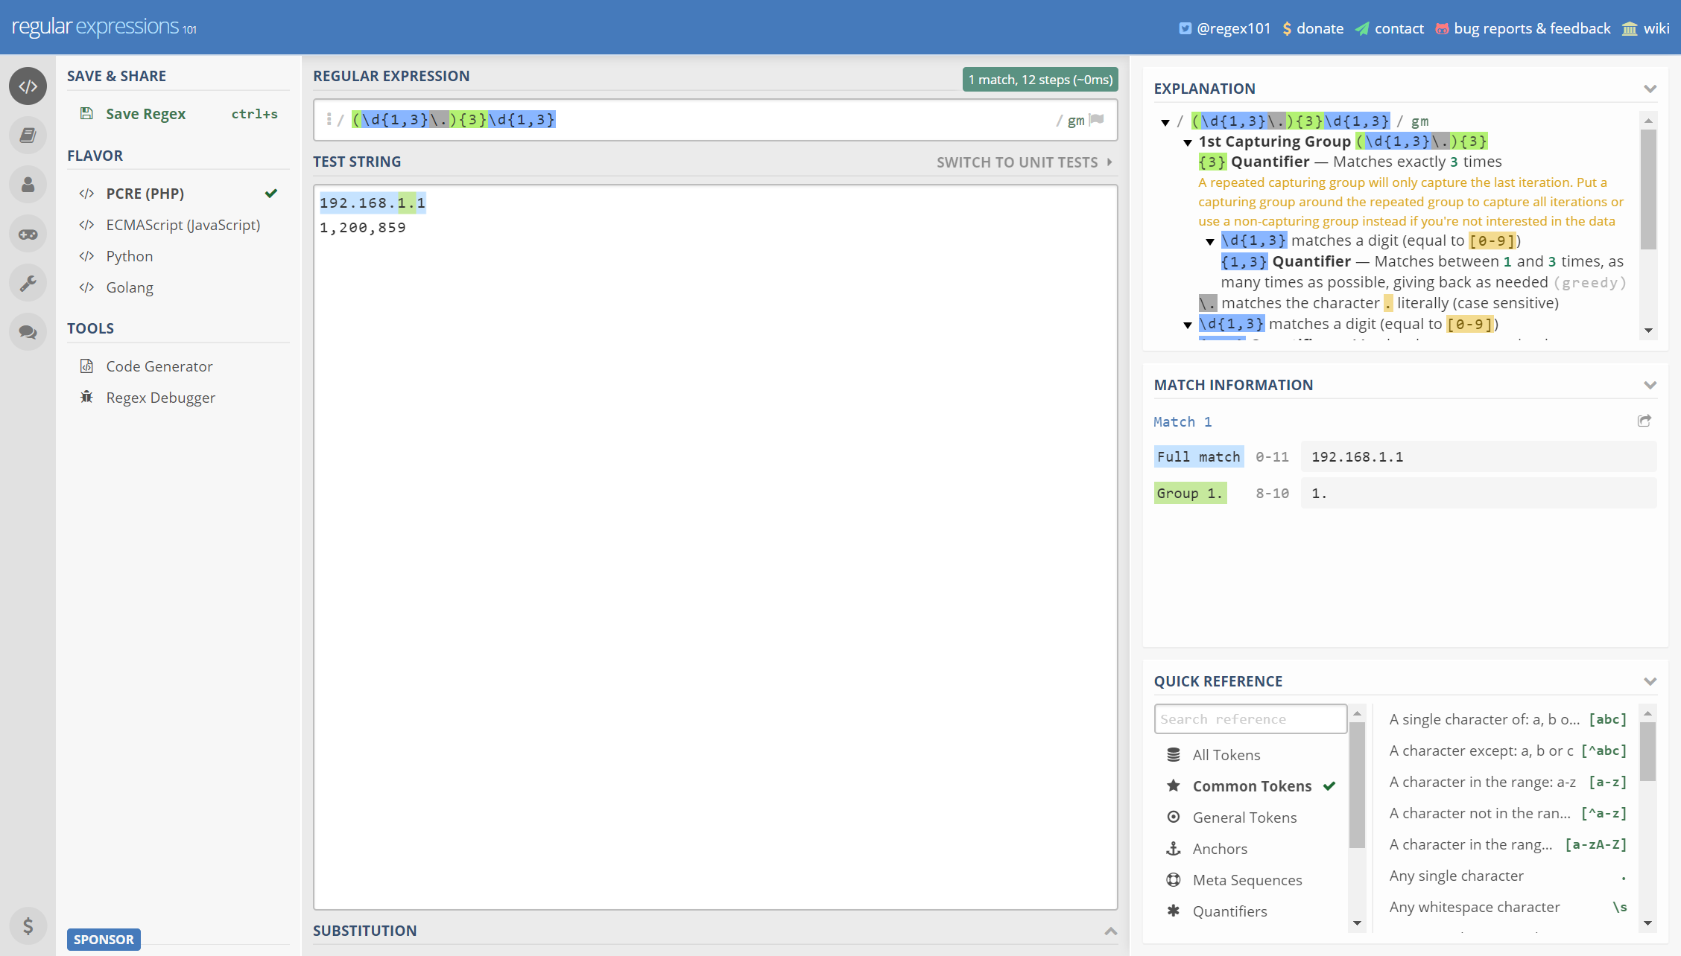
regex101.com

Slide 146
Thank you!
Thomas Rayner
Certified Information Systems Security Professional (CISSP)
Sr Security Service Engineer @ Microsoft
@MrThomasRayner

